Slide 1
Relaxed Garbage Collection
Emilia Vulpe | David R. White | Jeremy Singer

Slide 2

CONTEXT
What is Garbage Collection?
Why is Garbage Collection important?

Slide 3
Problem: How CAN WE IMPROVE GARBAGE COLLECTION? Solution: by introducing different heuristics for determining which objects to be removed from memory at a given time rather than wait for objects to die

Slide 4
Background: Elephant tracks
Elephant tracks is a tool that records events during a program’s runtime to keep information when objects are allocated in memory, used and removed from memory
We use this information to analyse objects’ lifetimes and find a good way to predict which objects won’t be needed in memory anymore
We record errors caused by accessing objects that were previously removed from memory

Slide 5
Background
The first part of the project consisted of writing a parser for extracting information from Elephant Tracks files
Secondly, heuristics for removing objects from memory were developed and tested
Thirdly, the results from the tests were analysed
Finally, documentation and user manual were provided

Slide 6
Implementation

Slide 7
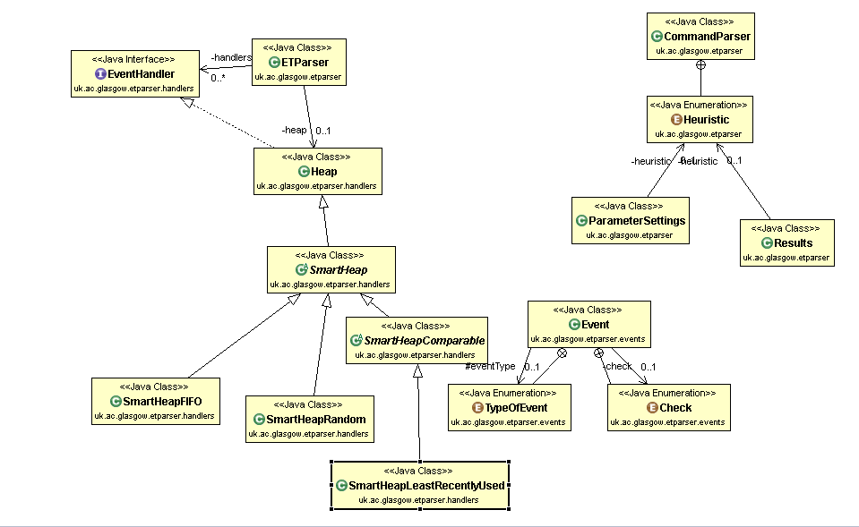
Implementation: Summary

Slide 8
Tests:
The benchmark used for testing my tool is Java Mandelbrot with size of the compressed .gz file 11 MB.
8 heuristics were tested in total
The tests were run with memory size starting at 50 MB and increasing to 200 MB with 25 MB incremental
% of objects to be cleared from memory once the whole space has been allocated were from the range 5-100% increasing by 5%

Slide 9
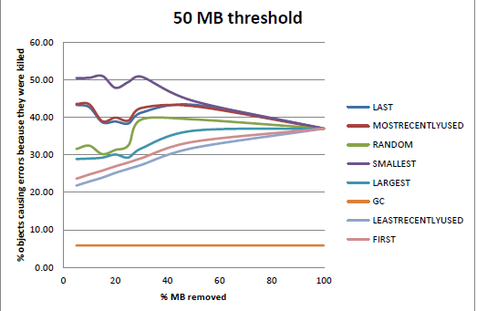
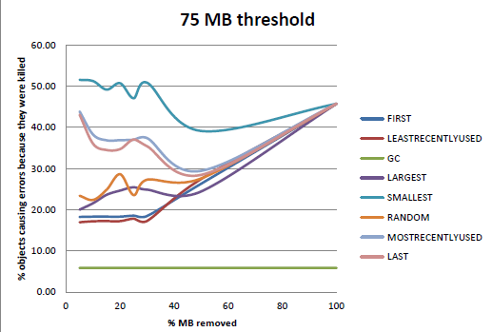
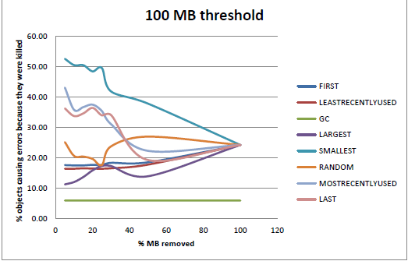
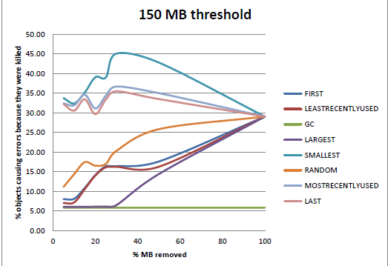
Results

Slide 10
What is next?
Tool is to be tested with more benchmarks and more memory sizes
Results are to be analysed
New heuristics are to be implemented based on the analysed results
Research study
Paper

